Slide 1
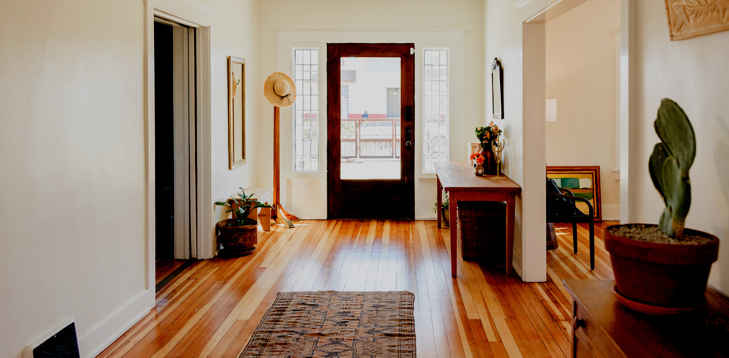
K723 Assignment 3
Evaluation of
Condos in Toronto
Presented By Yidi Geng

Slide 2

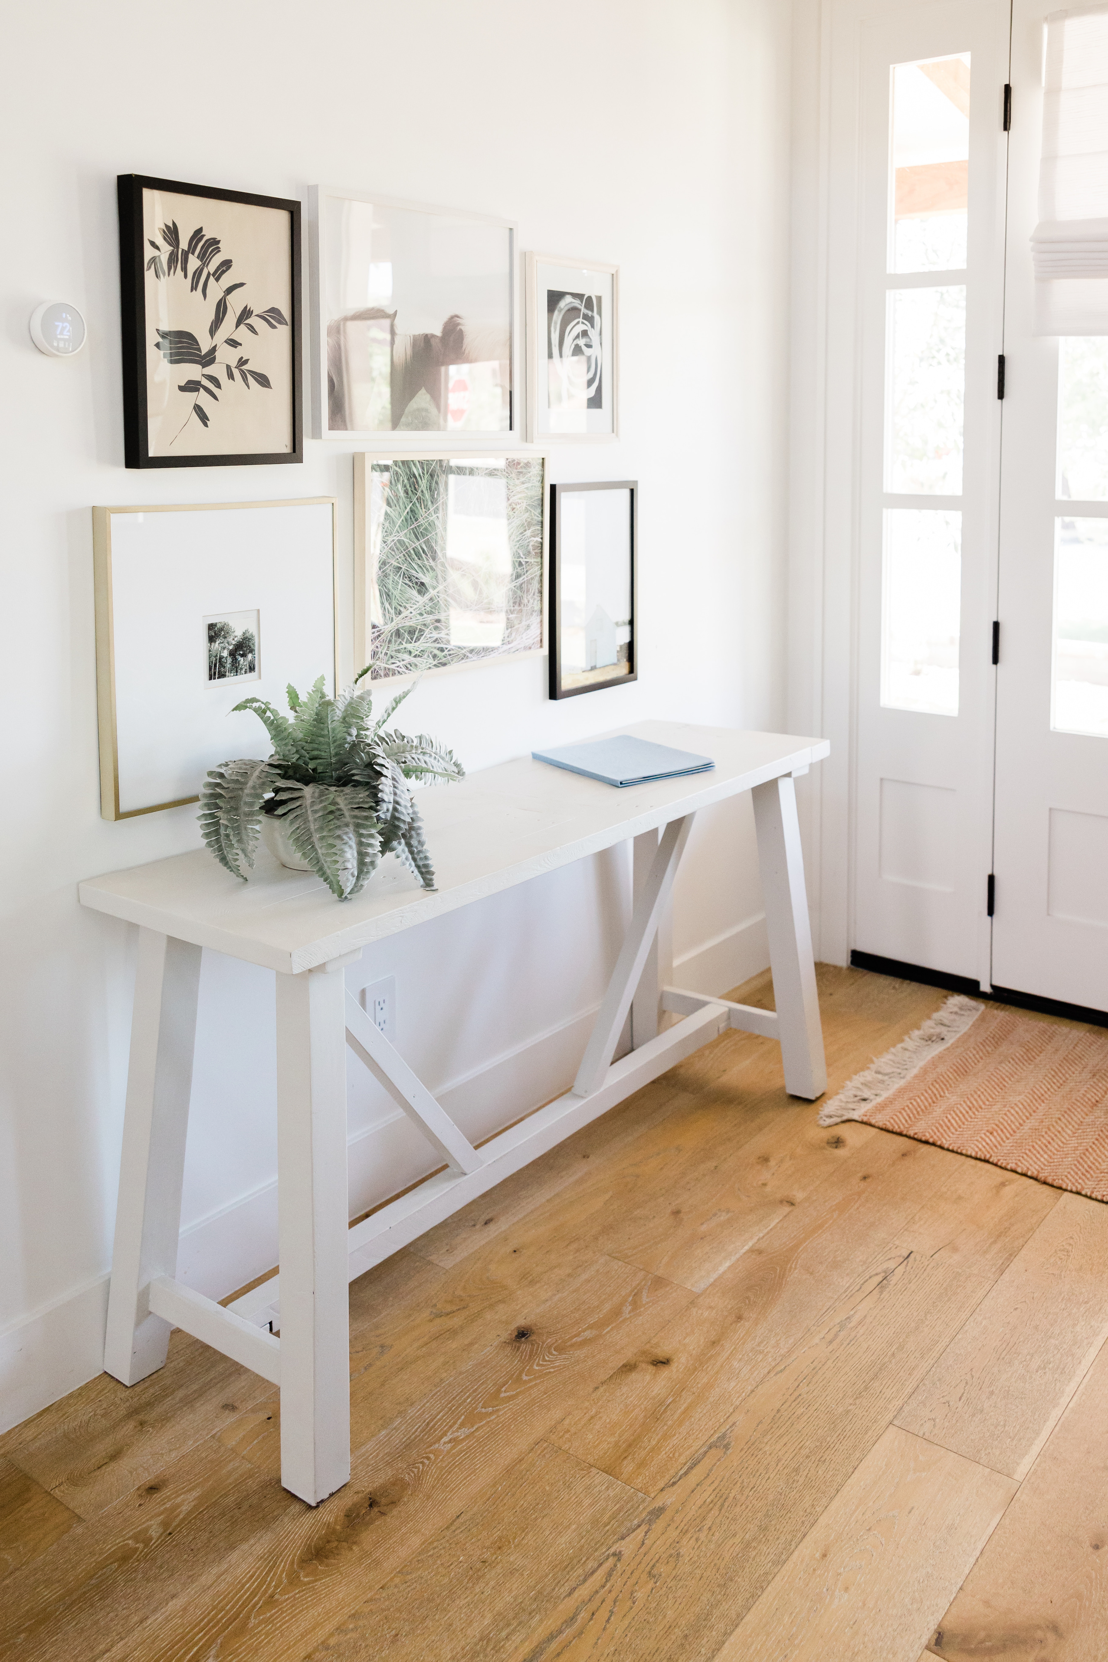
Background and Goal
This is an analysis for choosing an ideal condo to rent in Toronto base on the data from RentSafeTO apartment buildings standards program. The following slides will present some key findings and the process of narrowing down to the final decision from 3481 condos.
The ideal condo should at least meet following requirements:
Build later than 2000
Has underground parking
Close to highways or metro stations

Slide 3
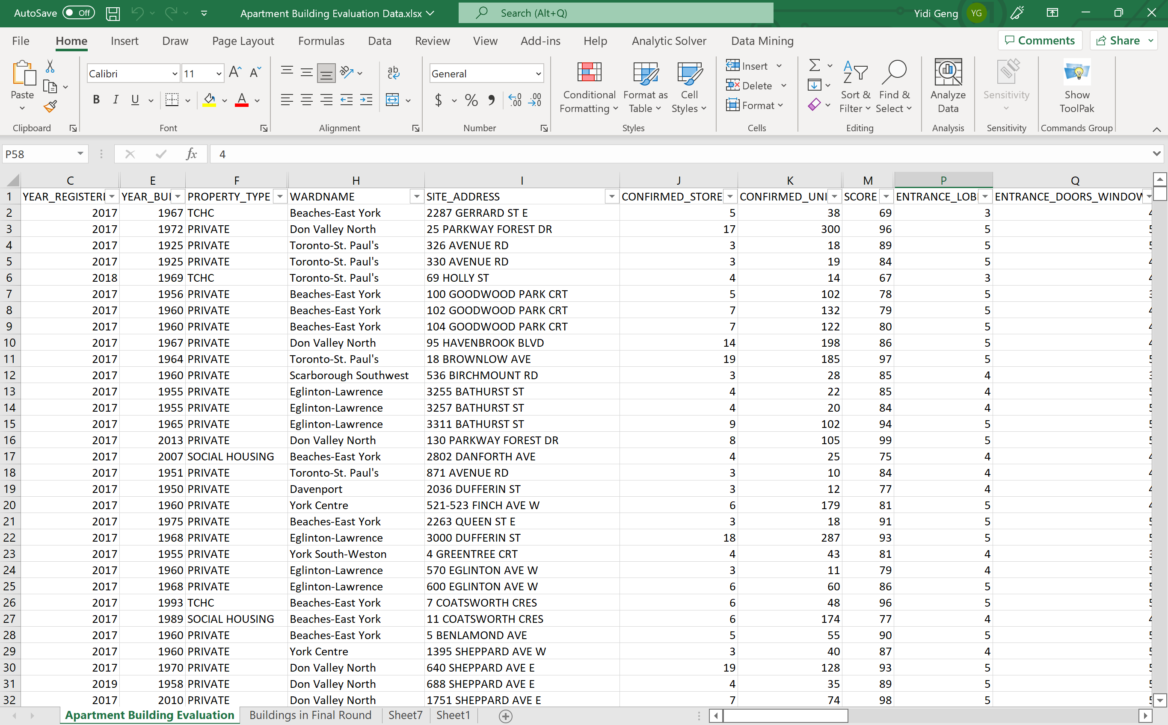
Intro of Dataset
This dataset contains building evaluation scores for buildings registered with RentSafeTO. Officers examine external grounds, parking, mechanical and security systems, and communal spaces while conducting examinations. Each item is examined and given a score between one(the lowest) and five (the highest). The score for an item will be displayed in the dataset as blank if it is not applicable to the building at the time of evaluation.

Slide 4

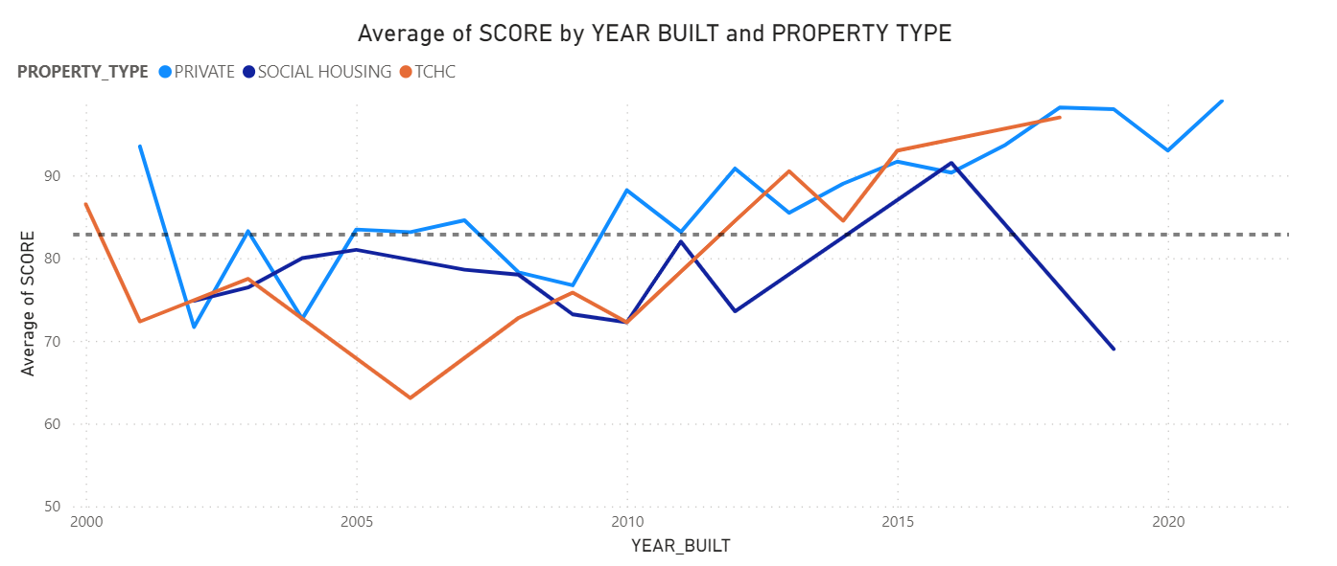
Step 1:
Confirm the relationship between building’s age, type, and its score
It is easy to say that the over all score of private owned condo is higher than the other two types at most of the time, and their scores has a positive relationship with the year built.
As the average scores of all private owned condos after 2010 is higher than the mean(black dush line). To narrow down the selection, only private owned condo that are built after 2010 will be considered in the following analysis.

Slide 5
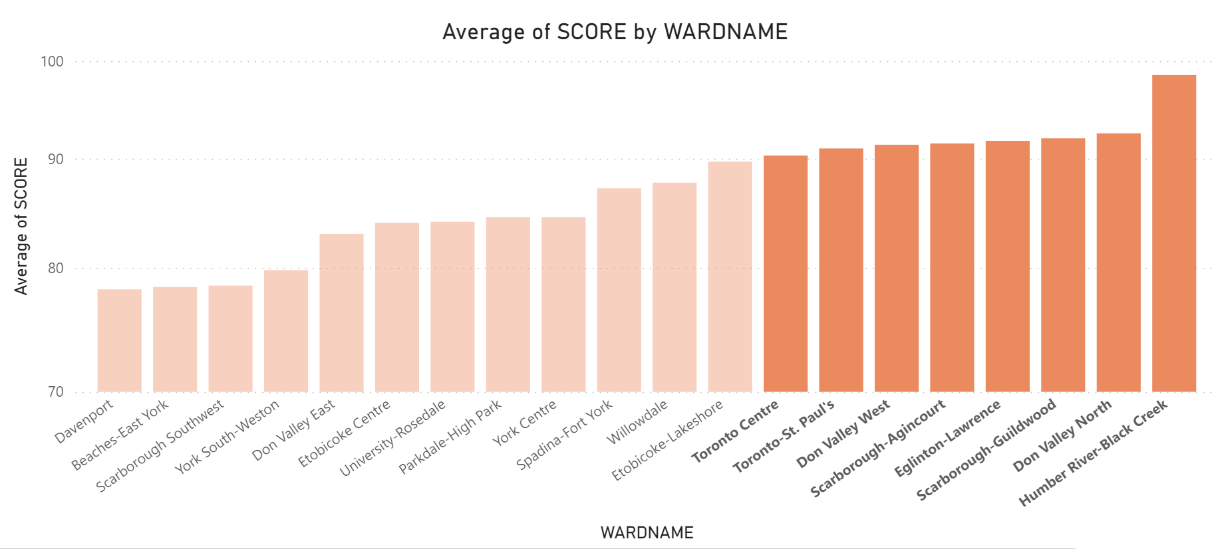
Step 2:
Pick the regions where condo scores are high
The bar chart shows the average scores of condos in each region from low to high.
In order to narrow down the selection range, only condos in those eight highlighted regions will be considered in further analysis.

Slide 6
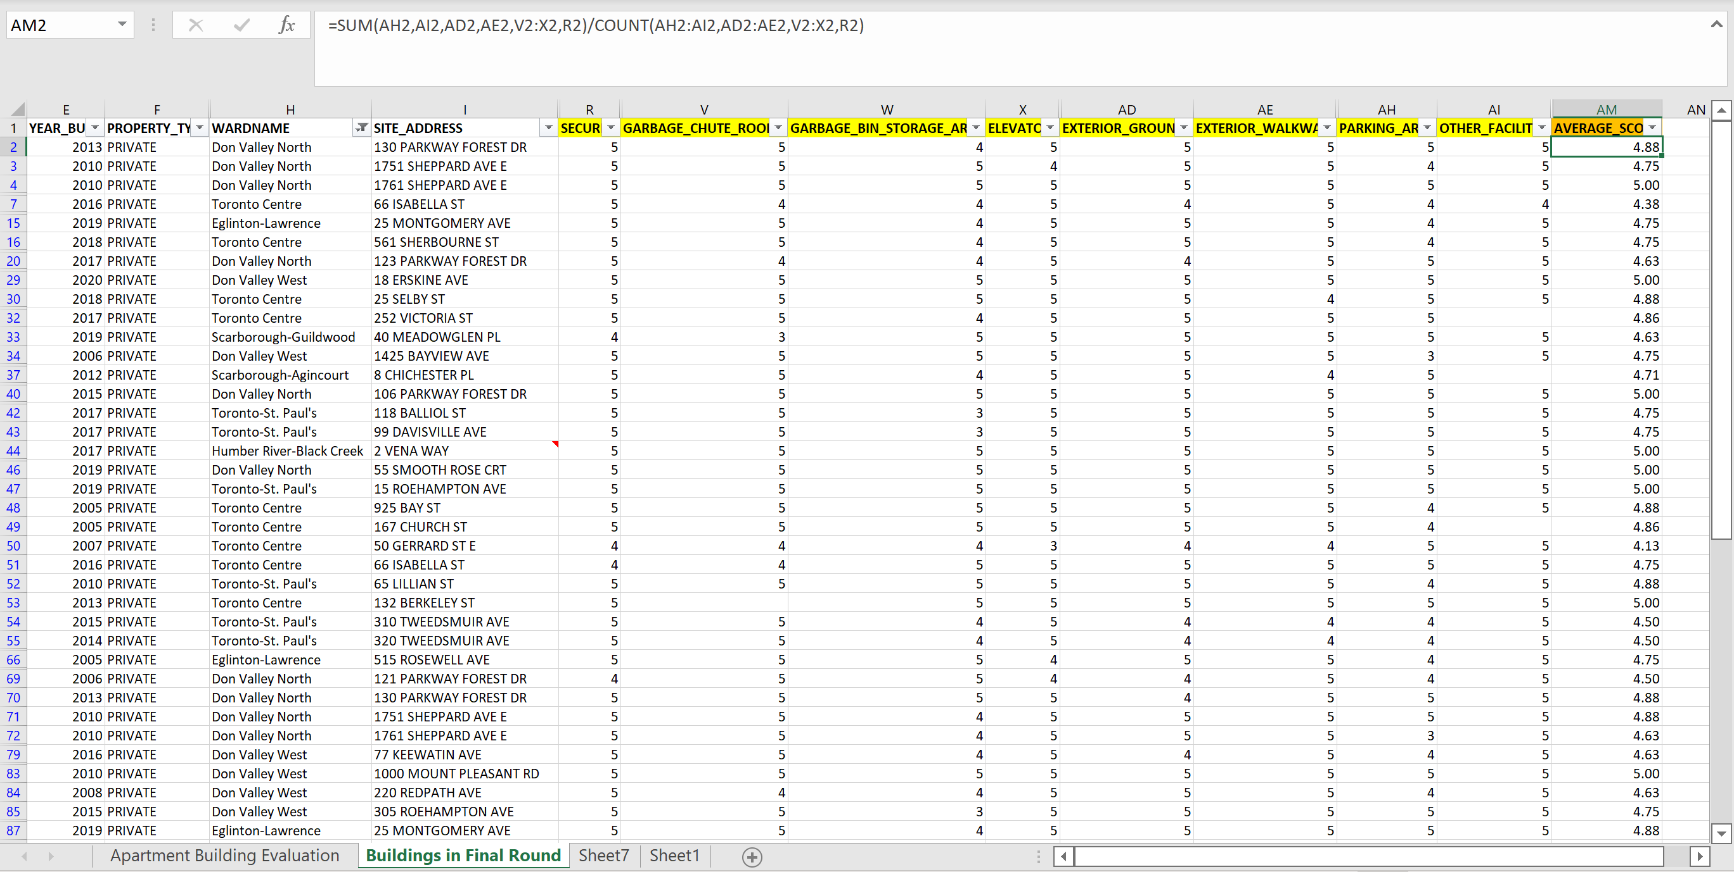
Step 3:
Re-calculate the score base on personal requirements
The RentSafeTo evaluates condos from 20 aspects. However, these aspects are not equally weighted from my point of view. I care more about the scores of security, garbage chute rooms, garbage bin storage area, elevators, exterior grounds, exterior walkways, parking area, and other facilities. Therefore, I calculated an average score of these aspects for each condo. Only condos that have 4.7+ average scores will be considered in further analysis.

Slide 7
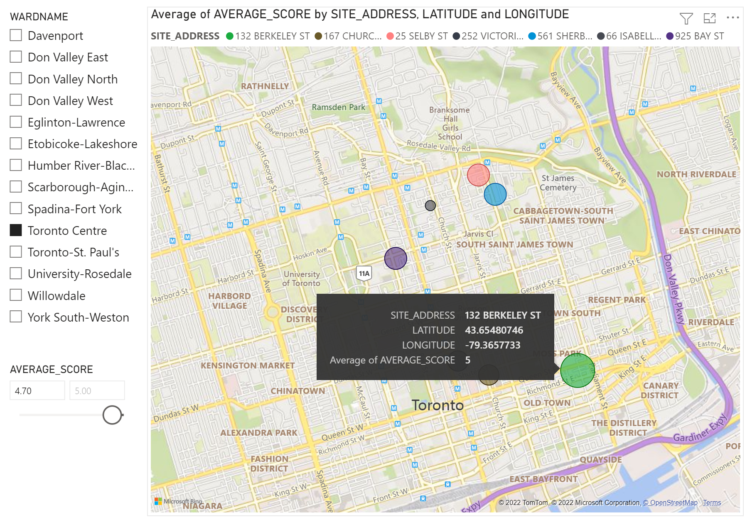
Step 4:
Find condos that close to highways or metro stations
The circle size represent the average score calculated in last step. The higher the score, the larger the size of ​​the circle.
In Toronto Centre, 132 Berkeley St has the highest score, and it is also the closest to highway( highlighted in purple).

Slide 8
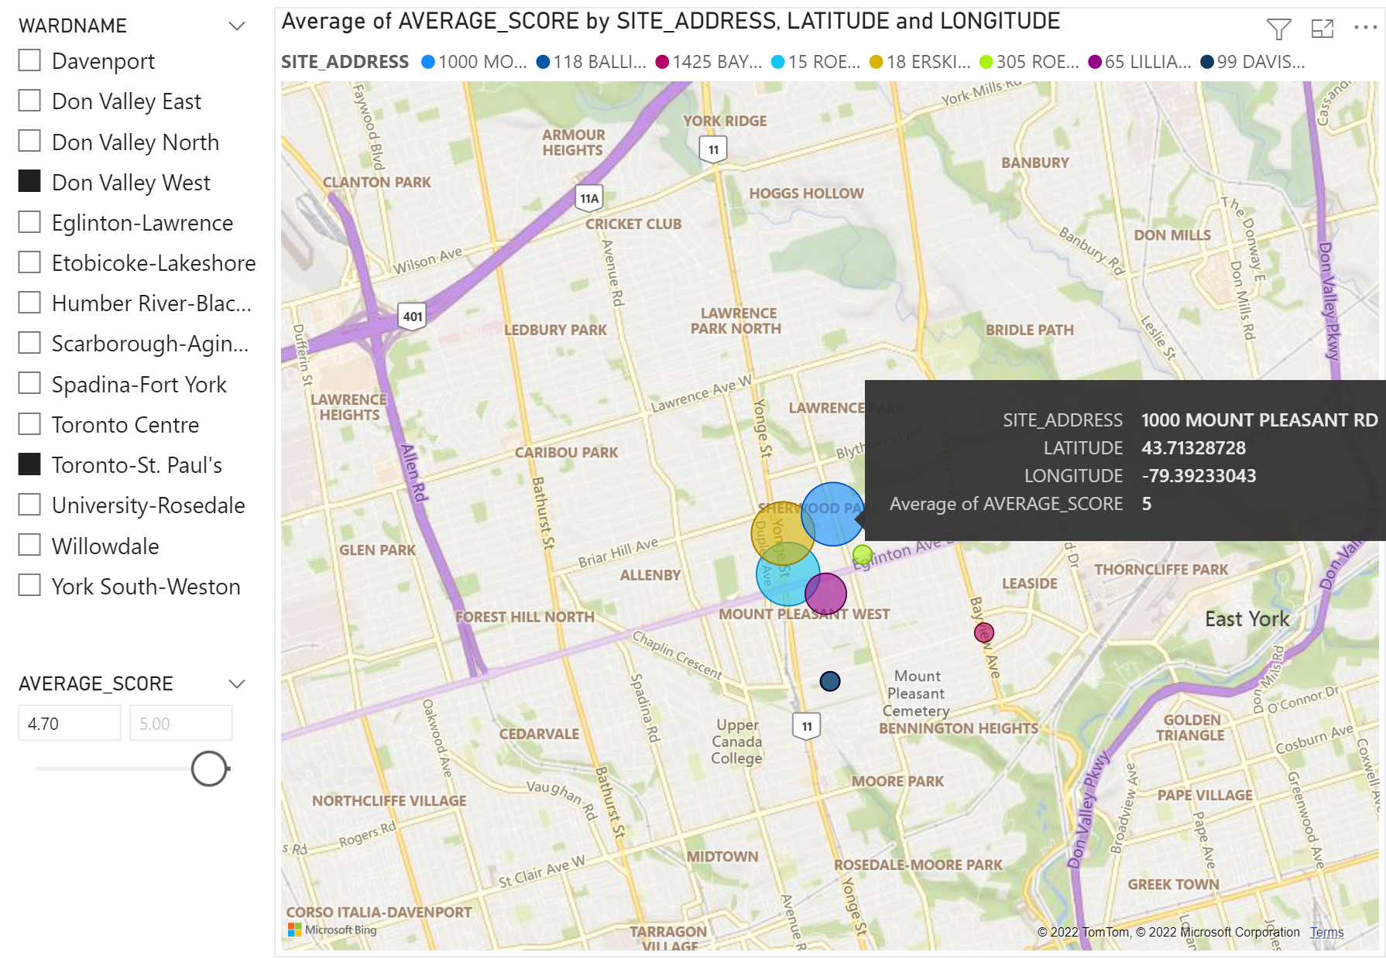
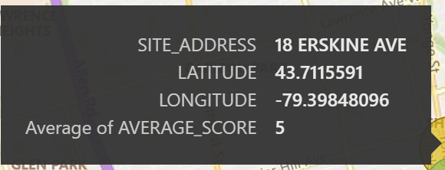
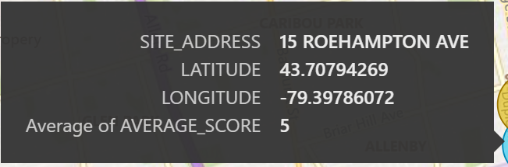
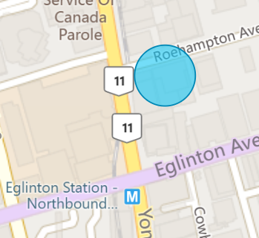
Step 4:
Find condos that close to highways or metro stations
The Don Valley West and Toronto St. Paul’s region are close, therefore condos in these two regions were showed together in this picture.
1000 Mount Pleasant RD, 18 Erskine Ave, and 15 Roehampton Ave all have scores of 5.
They are a bit far away fromthe highway.
However, 15 Roehampton Ave is close to the metro station.

Slide 9
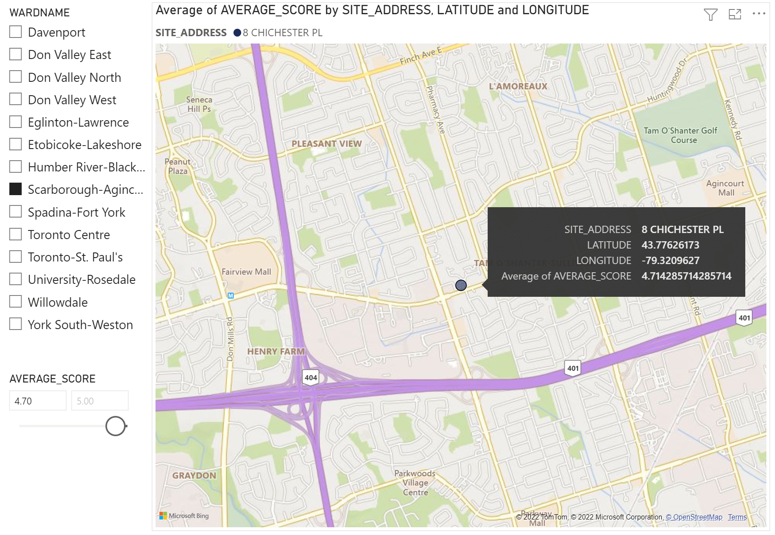
Step 4:
Find condos that close to highways or metro stations
Only 8 Chichester PL in Scarborough-Agincourt has a average score higher than 4.7
It is close to the highway, however the score is not too high

Slide 10
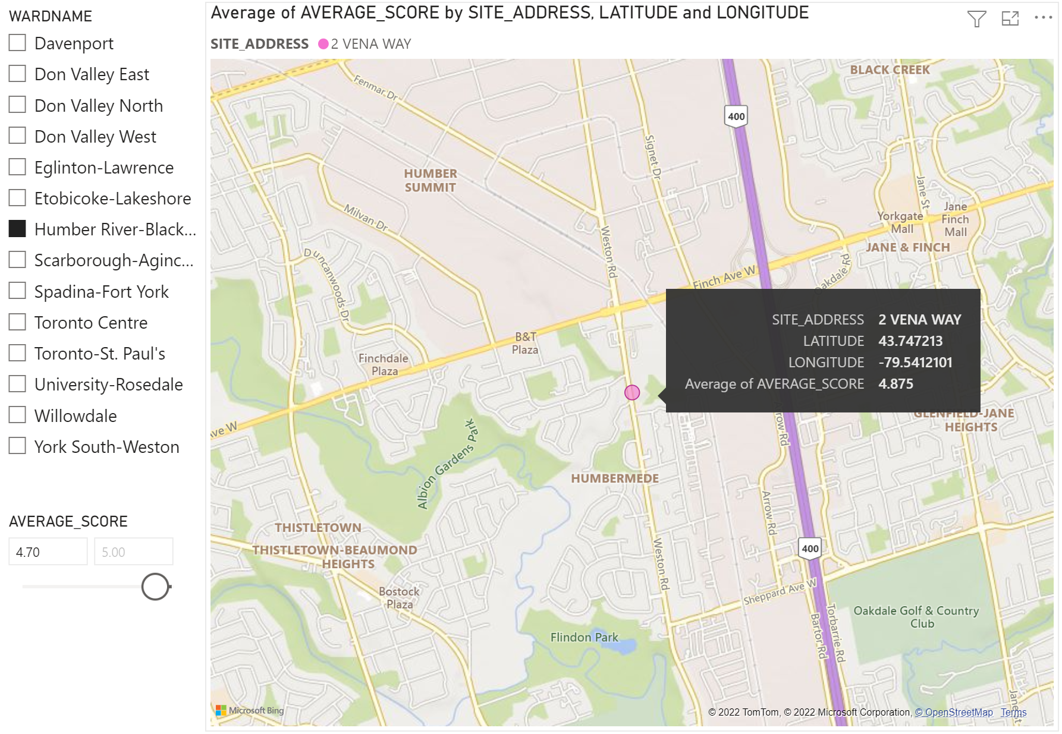
Step 4:
Find condos that close to highways or metro stations
Only 2 Vena Way in Humber River-Black Creek has a average score higher than 4.7
It is close to the highway, however the score is not too high

Slide 11
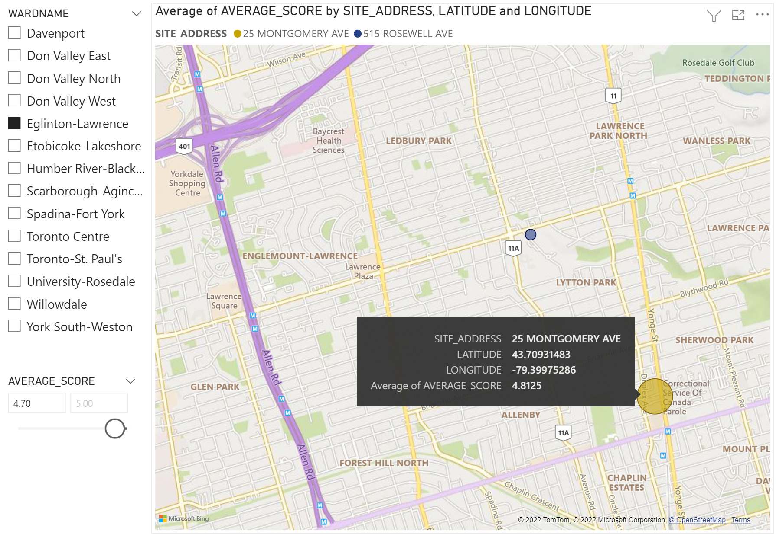
Step 4:
Find condos that close to highways or metro stations
Only 25 Montgomery Ave in Eglinton-Lawrence has a average score higher than 4.7
Close to the metro station, however the score is not too high

Slide 12
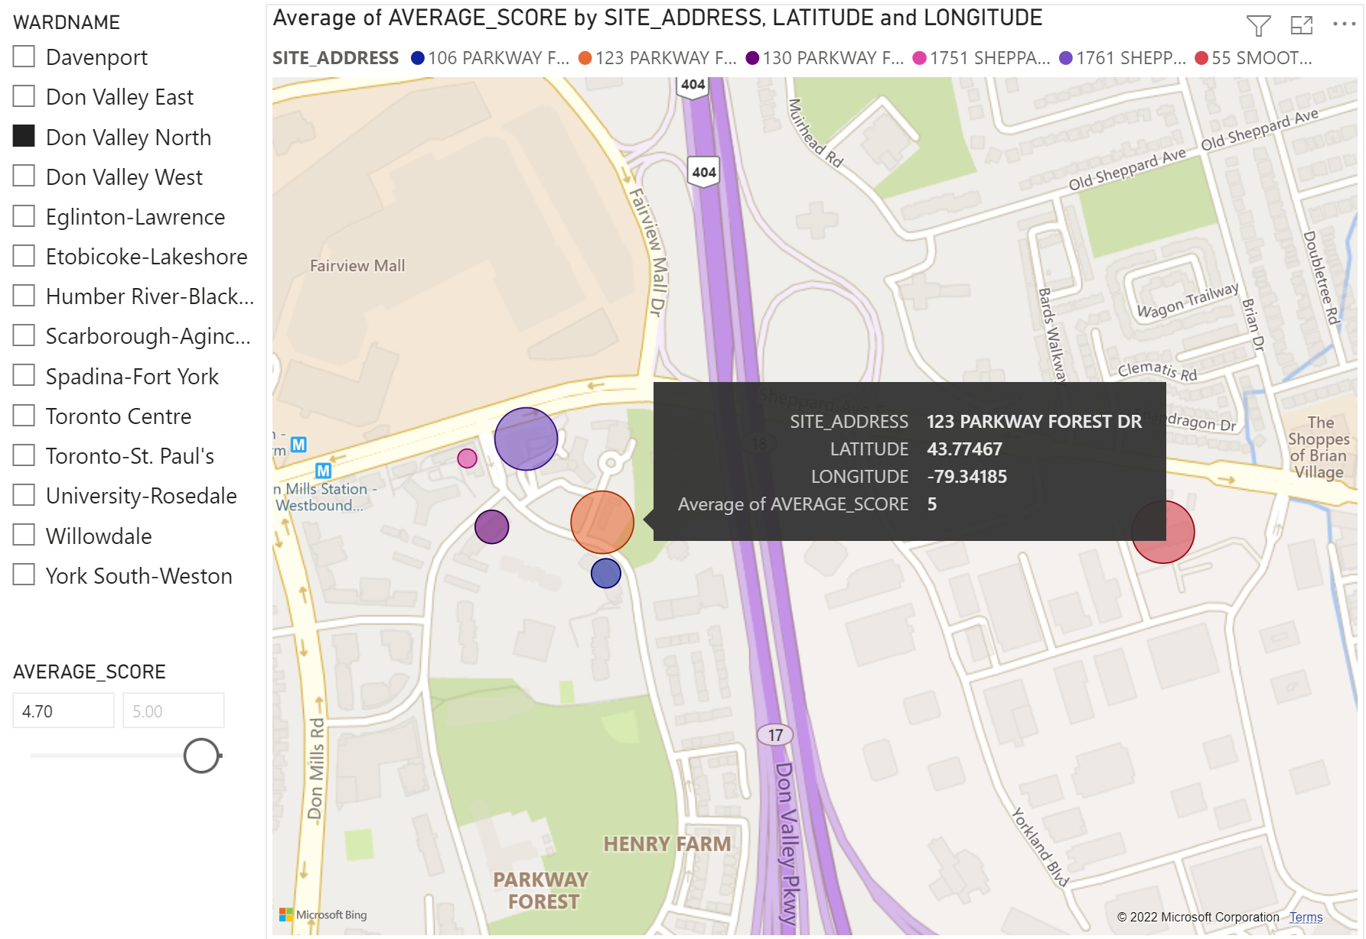
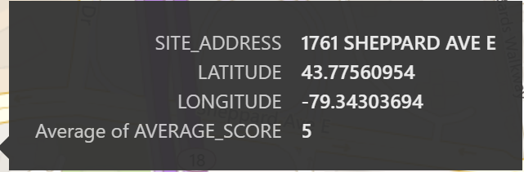
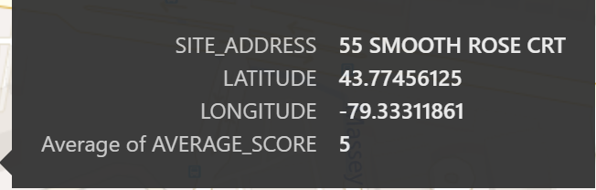
Step 4:
Find condos that close to highways or metro stations
1761 Sheppard Ave E, 123 Parkway Forest Dr, and 55 Smooth Rose Crt all get score of 5.
They are close to each other and are all close to the highway.
1761 Sheppard Ave E, 123 Parkway Forest Dr are also close to the metro station.

Slide 13
Step 4:
Find the rental price and make the final decision
Condo Address | Score | Rental of 1 Bedroom 1 Bathroom (source: https://www.zumper.com/)
132 Berkeley St, Toronto Centre | 5 | $2500
15 Roehampton Ave, Toronto St. Paul’s | 5 | $2631
1761 Sheppard Ave E, Don Valley North | 5 | $2350
123 Parkway Forest Dr , Don Valley North | 5 | $2350
The rental at 1761 Sheppard Ave E and 123 Parkway Forest Dr are the same and lower than others.
They are not only close to the highway but also close to metro station
Overall, I will visit these two condos and made my final decision between them.

